Slide 1
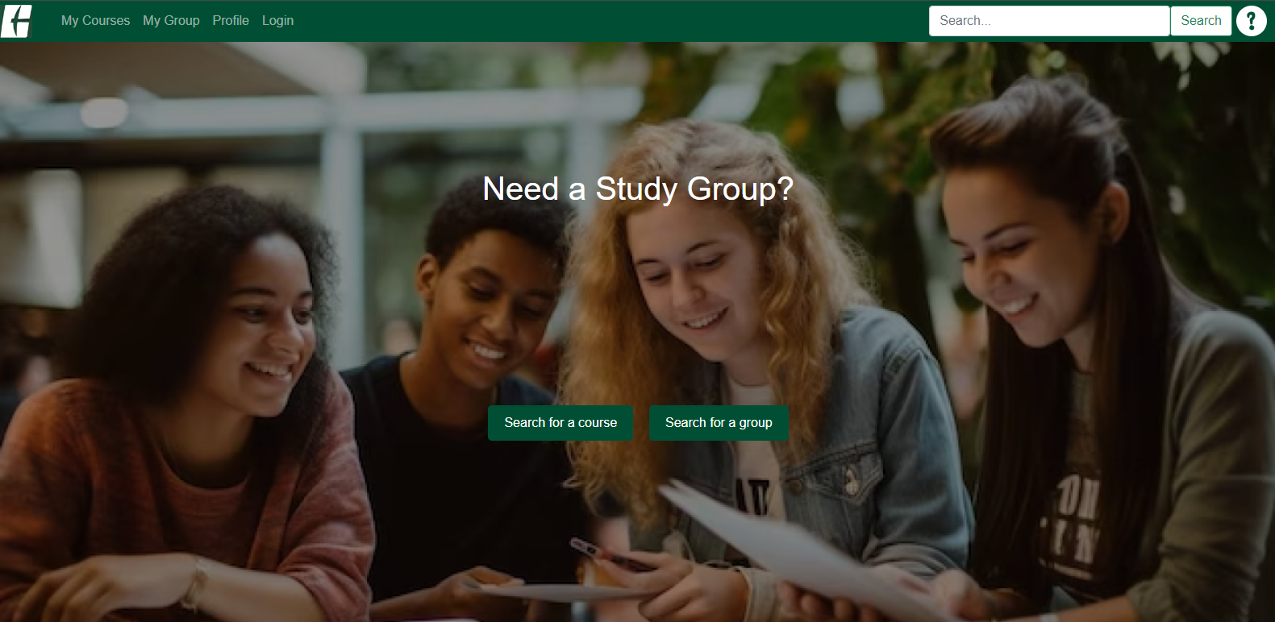
To use ClassPlus, Login is required!

Slide 2
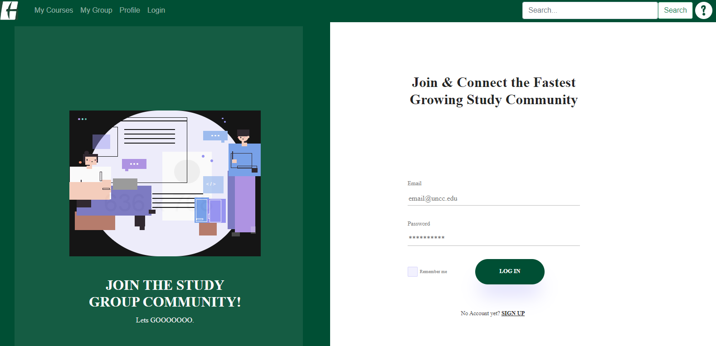
To login, enter Email and Password,
And click the LOGIN button.
If you don’t have an account, you can sign up here.

Slide 3
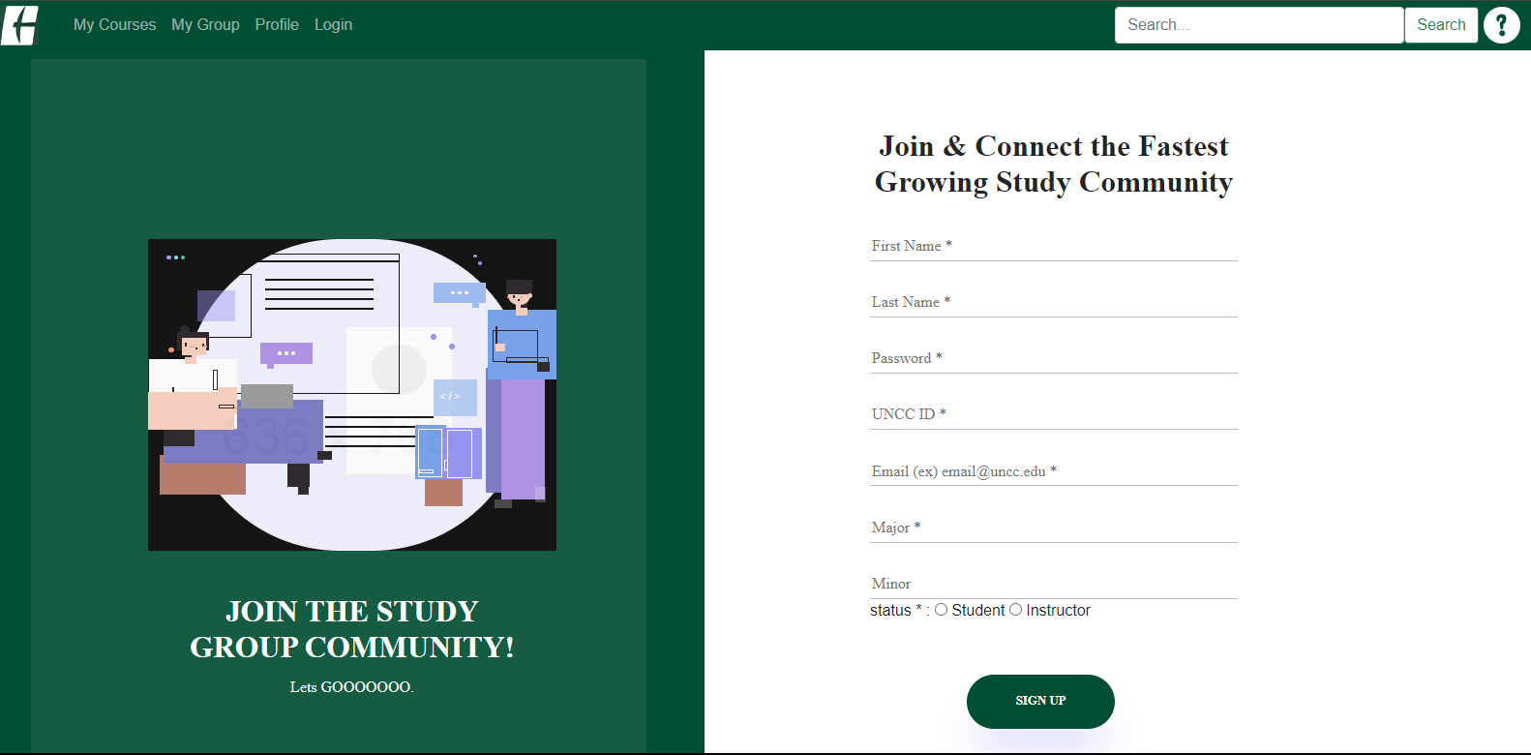
1. Make sure to fill out first name, last name, password, UNCC ID, email, major, and status.
2. And then click the signup button.

Slide 4

Profile pages
Groups that you’re joined in this semester
Courses that you’re enrolled in this semester
You can search for a course
You can search for a group

Slide 5
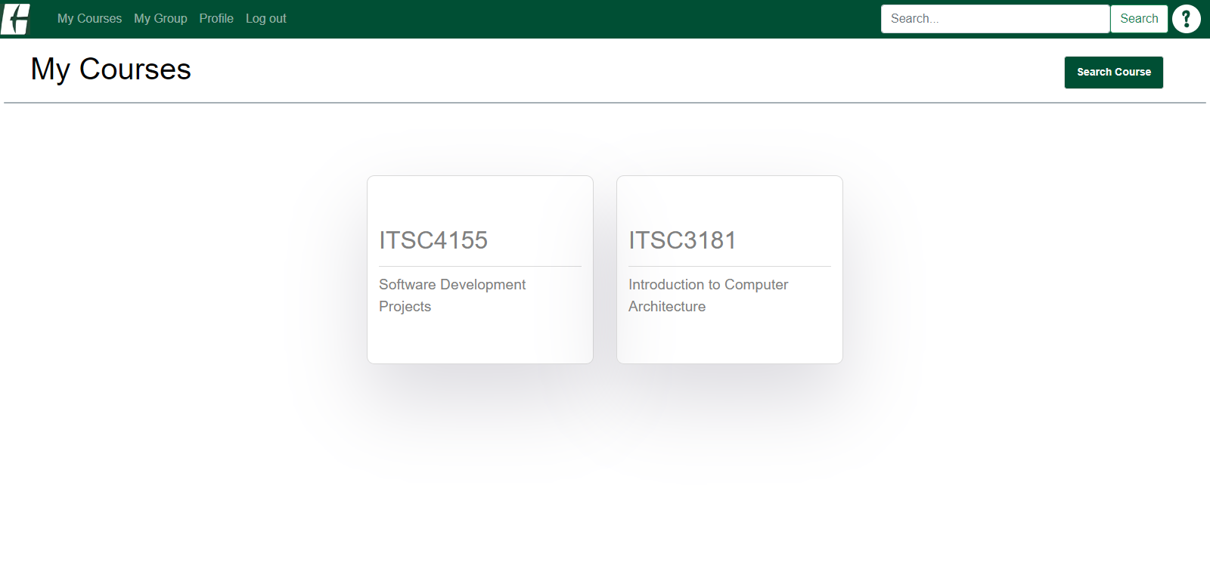
If you’re enrolled in at least one course, you will see the courses here.
You can click any course.
You can search for a course here.

Slide 6
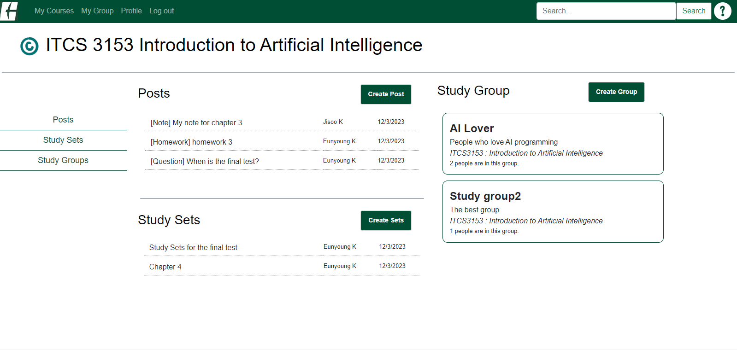
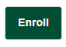
If you’re not enrolled in the course, you’ll see the enroll button.
You can view the recently created posts, study sets, and groups here.
The creating button is shown to people who are enrolled in the course.
To check out more activities, you can go to the sub menu here.

Slide 7
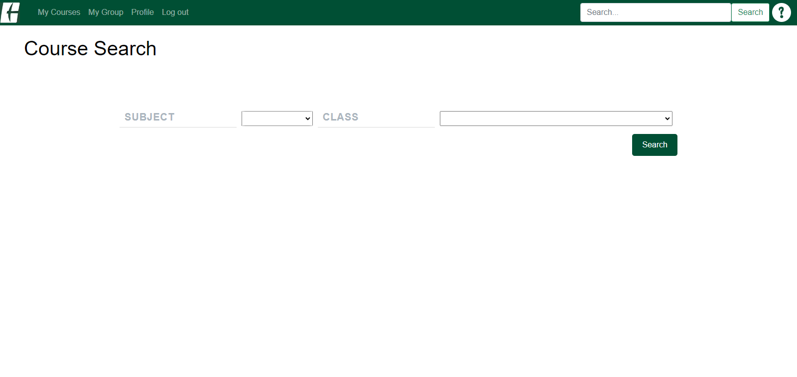
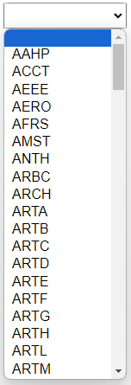
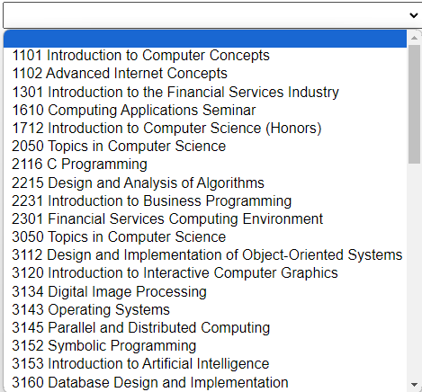
2. It will show courses like below.
1. Once you select subject here,

Slide 8
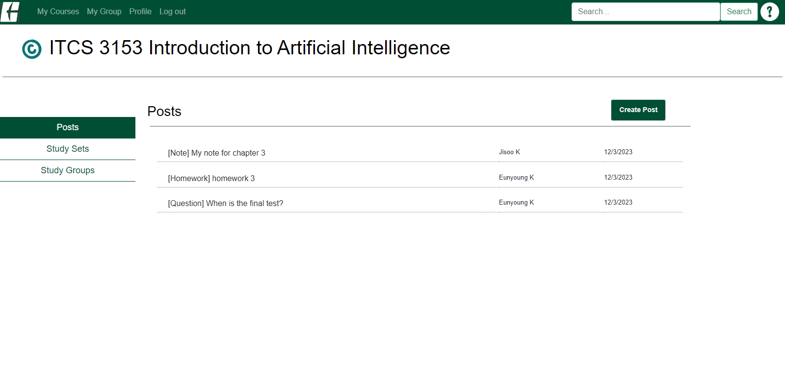
You can create a post if you’re enrolled in the course.

Slide 9
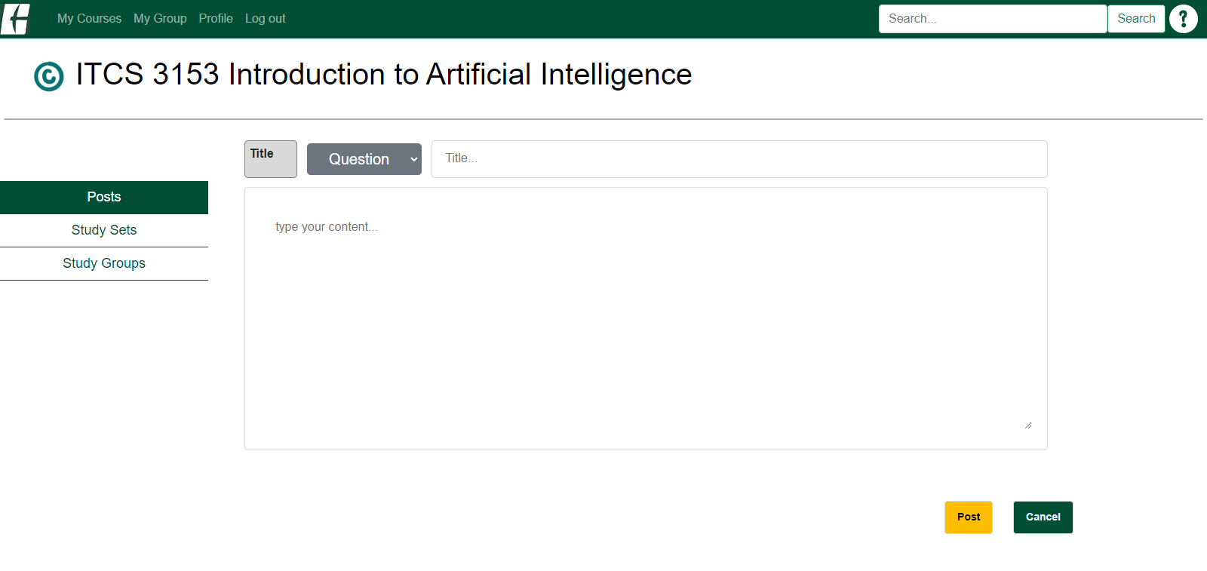
You can select post type, enter title, and write content here.

Slide 10
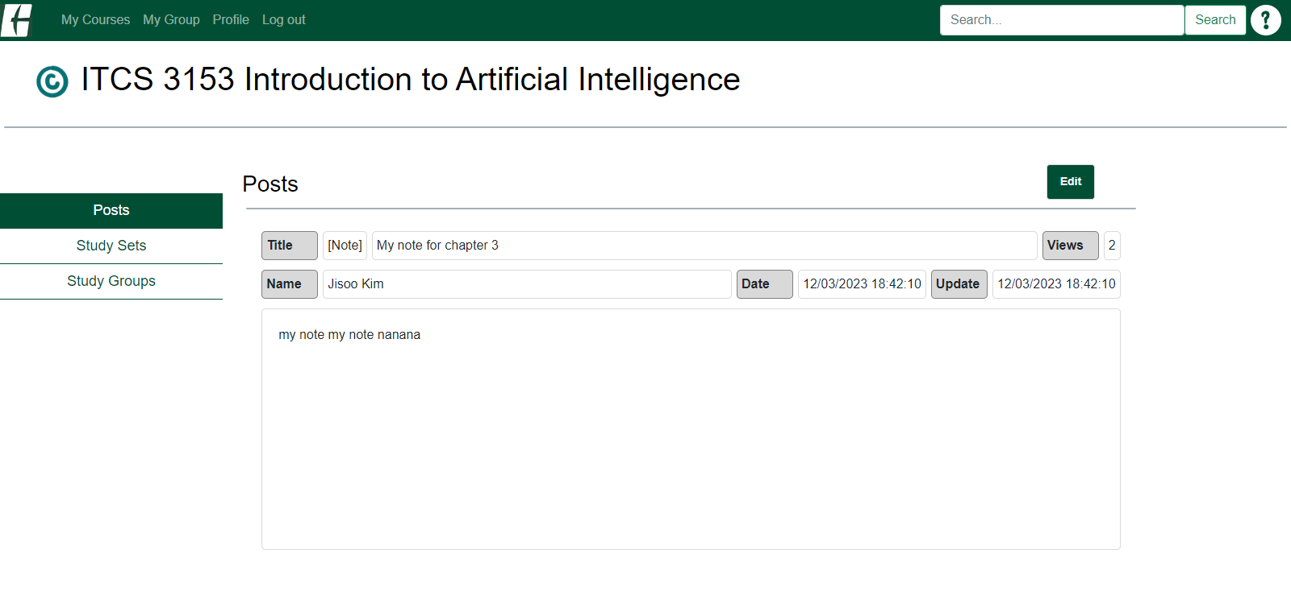
If you created the post, you’ll see the edit button. Other students can’t see it.

Slide 11
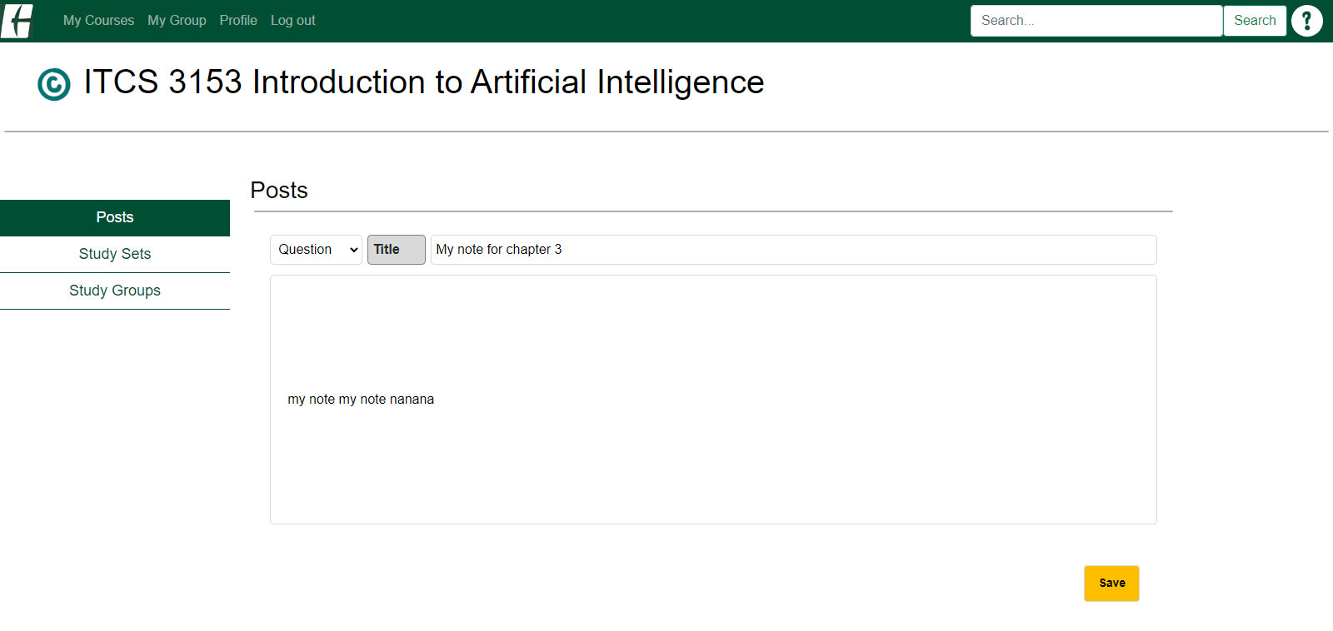
You can edit post type, title, and content here.

Slide 12
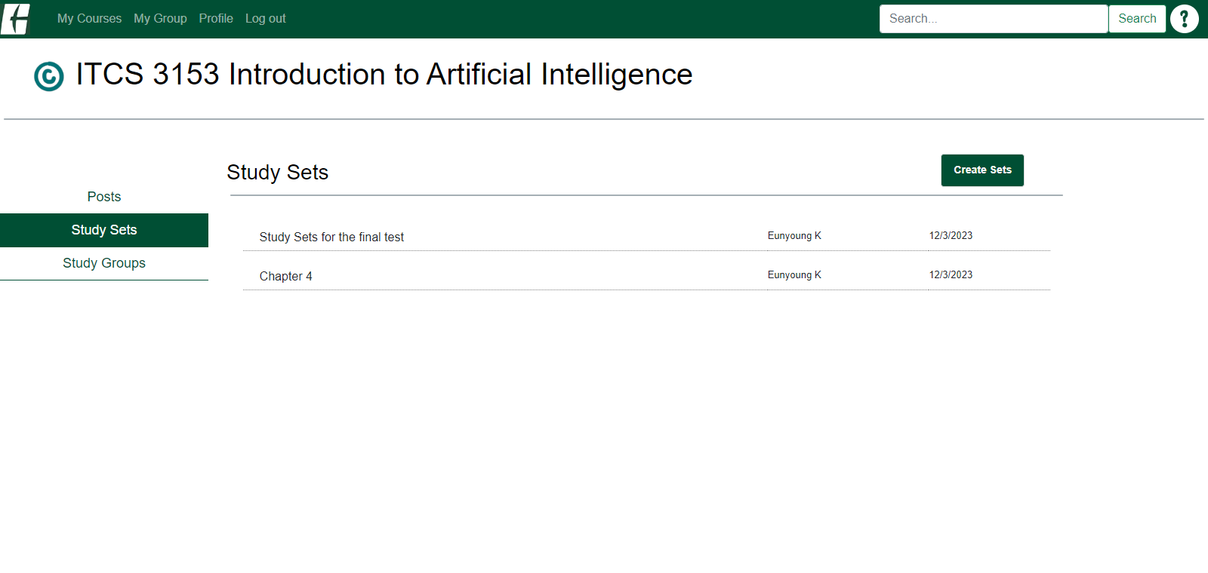
You can create study sets if you’re enrolled in the course.

Slide 13
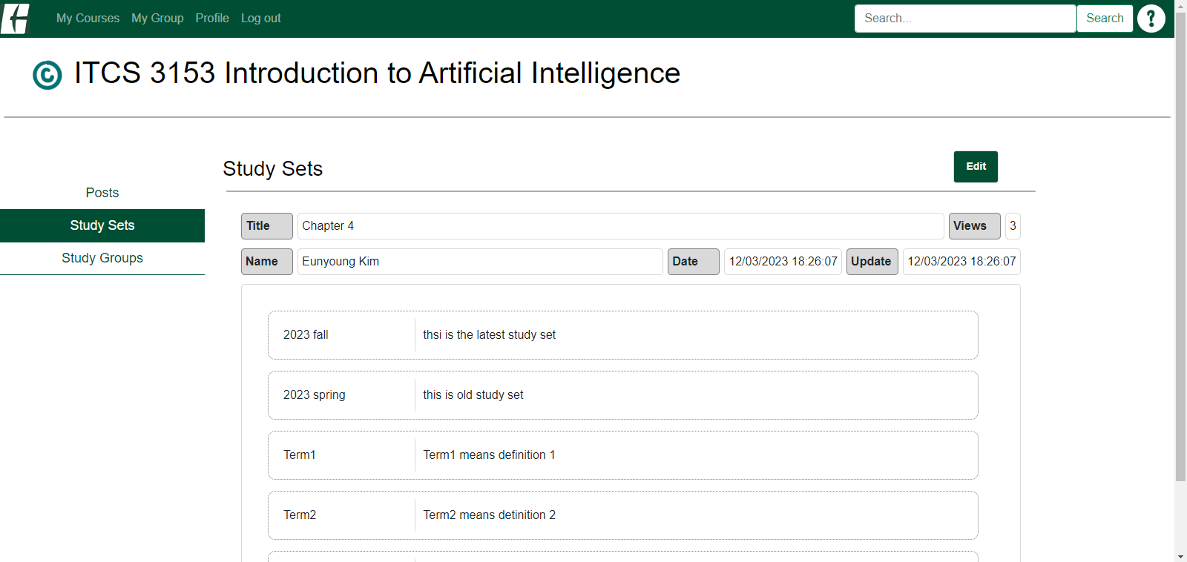
If you created the study set, you’ll see the edit button. Other students can’t see it.

Slide 14
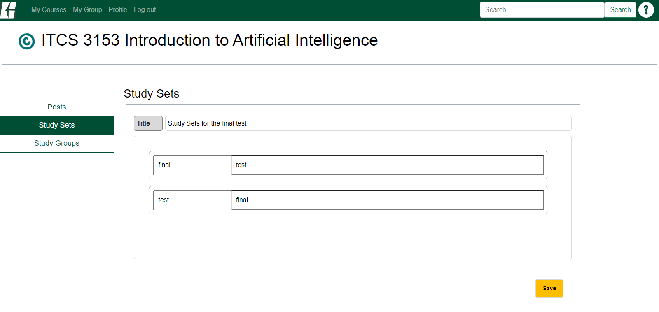
You can edit title, terms, and definitions.

Slide 15
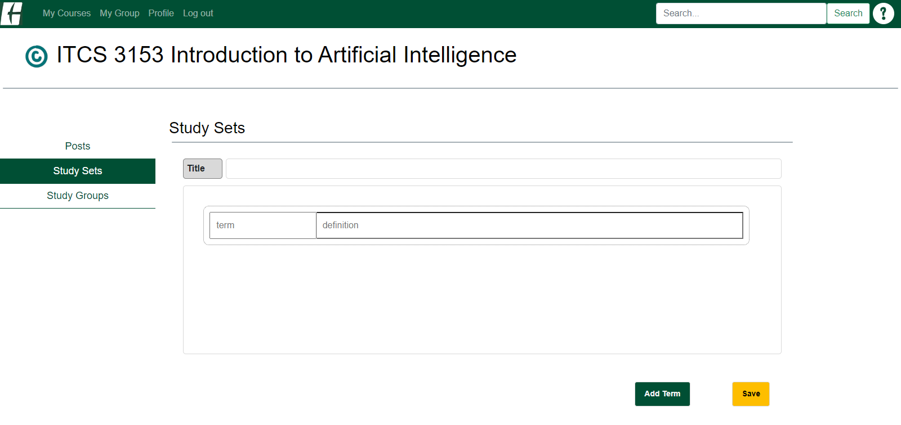
You can enter title, terms, and definitions.
If you want to add more terms/definitions, you can click this button.

Slide 16
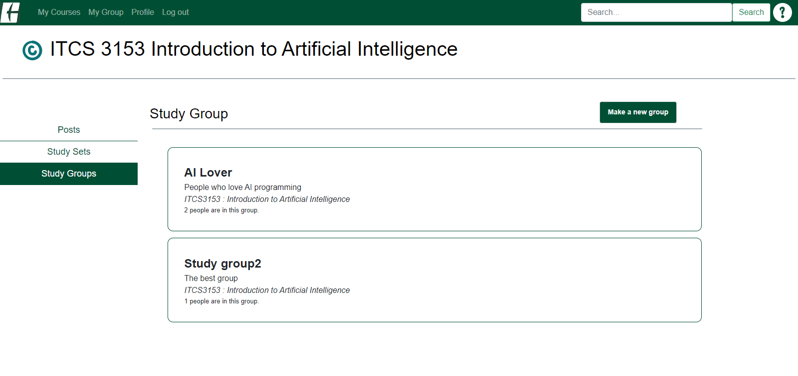
You can create a new group if you’re enrolled in the course.

Slide 17
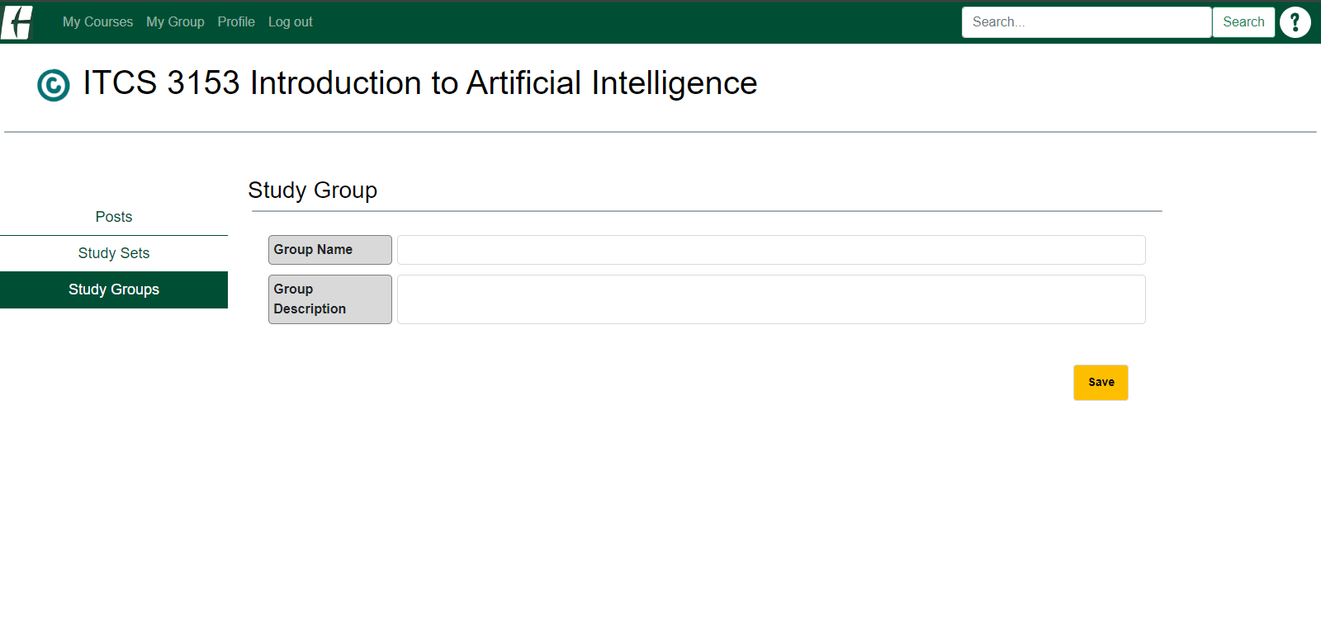
You can enter a group name and group description.

Slide 18
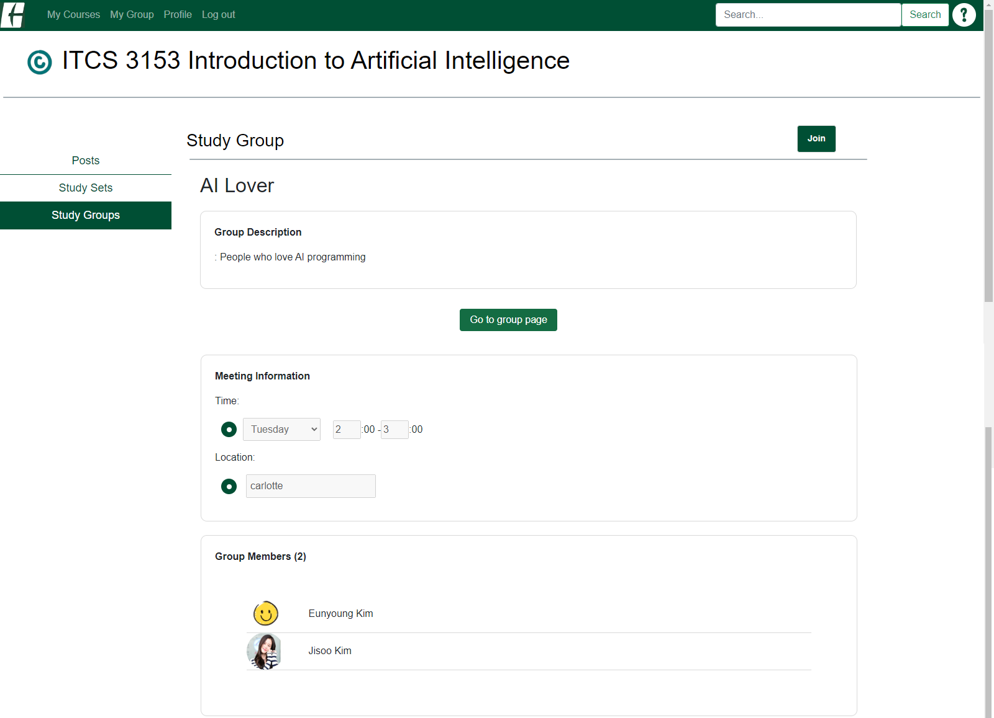
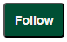
If you’re not joined in the group, you can see the join button.
You can go to the group page where you can set up group meeting information.
If you’re joined in the group, you can follow students in the group.

Slide 19
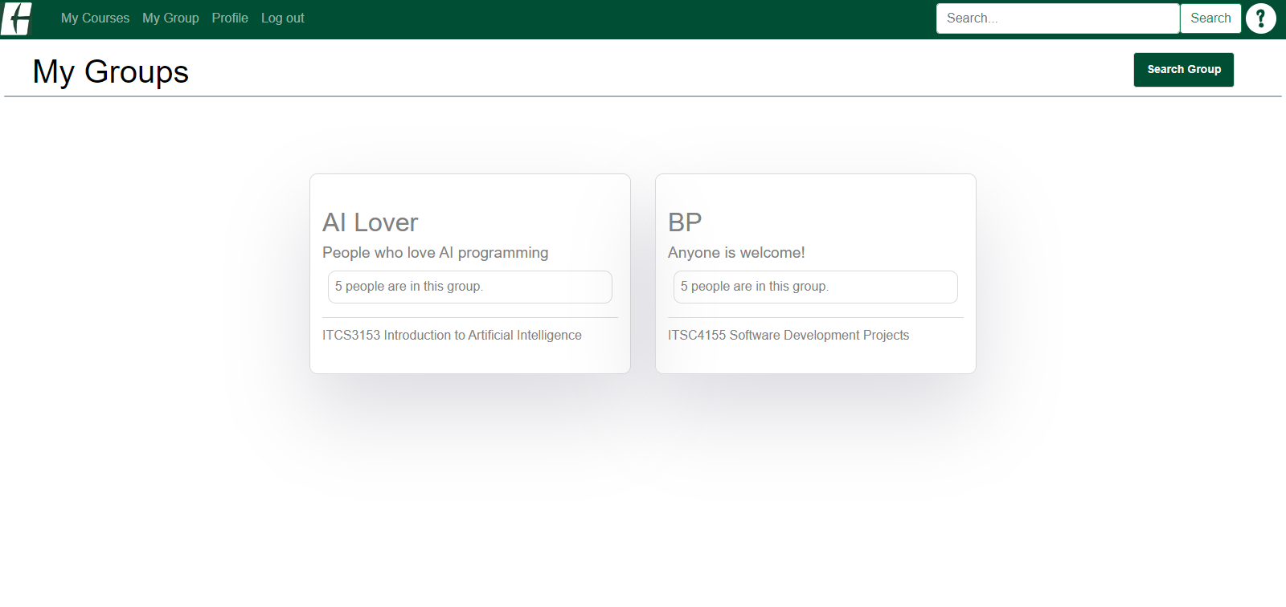
You can search for a group here.
If you’ve joined in at least one group in this semester, you will see the groups here.

Slide 20
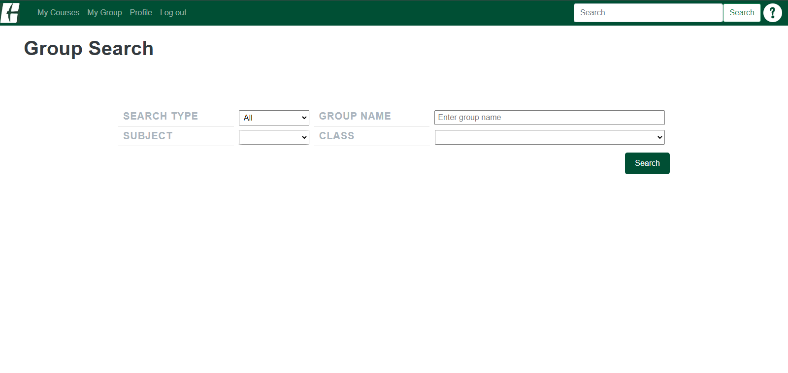
You can search for groups by course, group name, or both.

Slide 21
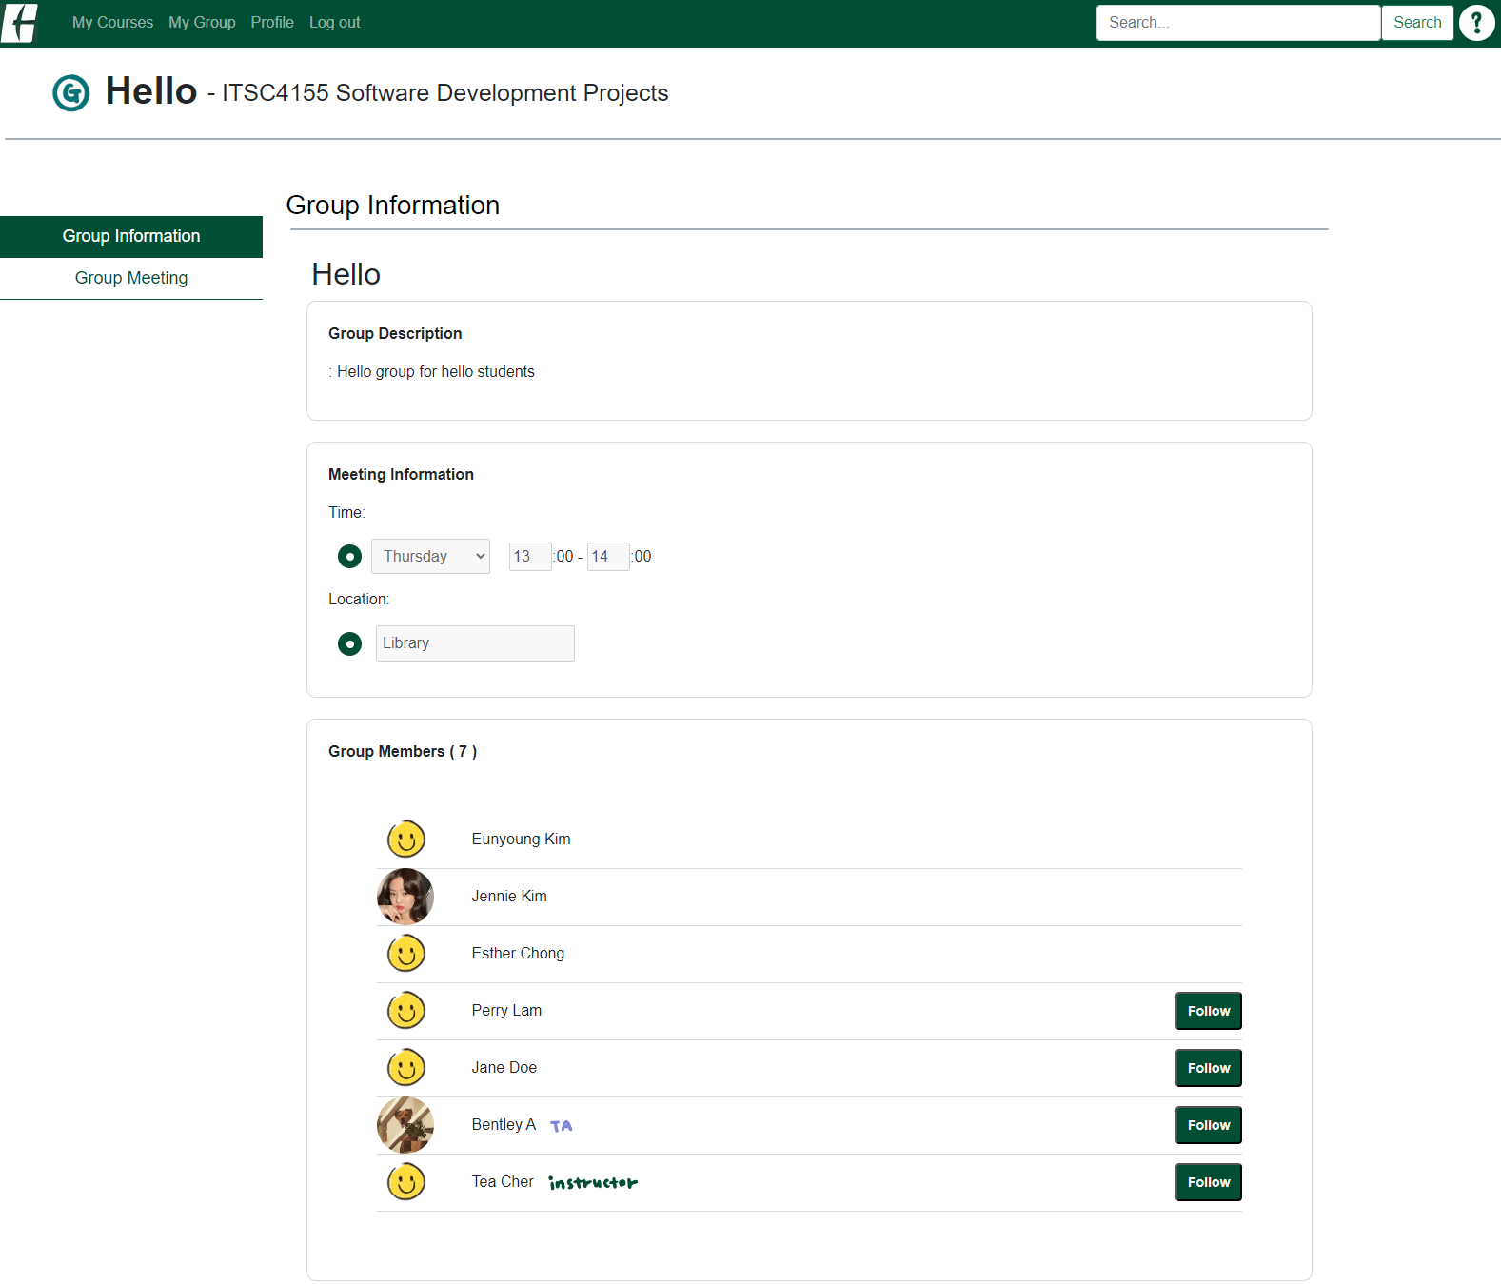
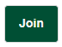
If you’re enrolled in the course, and not joined in this group, you’ll see the join button.
To check out more group activities, you can go to the sub menu here.
If you’re joined in the group, you can follow students in the group.

Slide 22
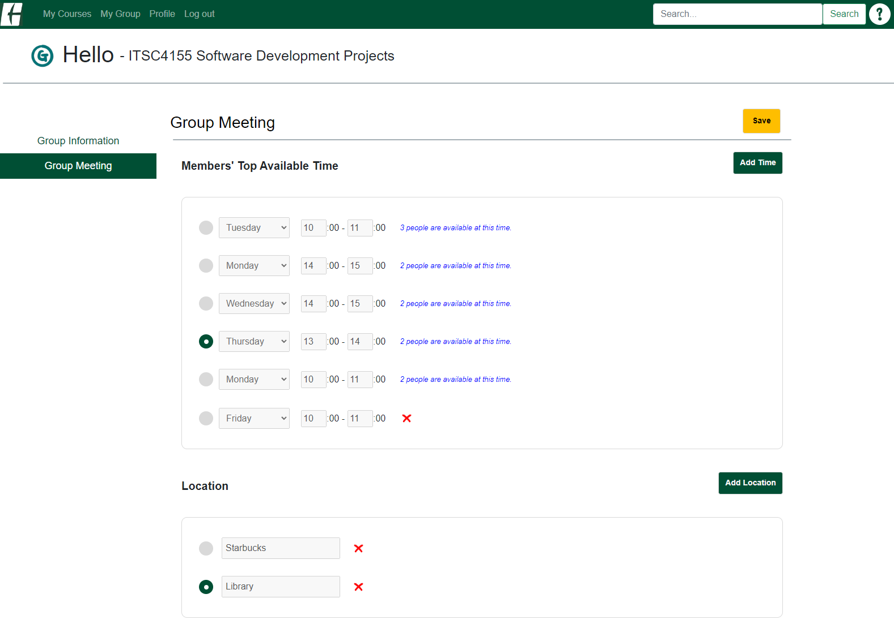
It shows group members’ top available time, and you can still add different time.
Once you select the time and location for a group meeting, you can save the information.
You can add a location for a group meeting

Slide 23
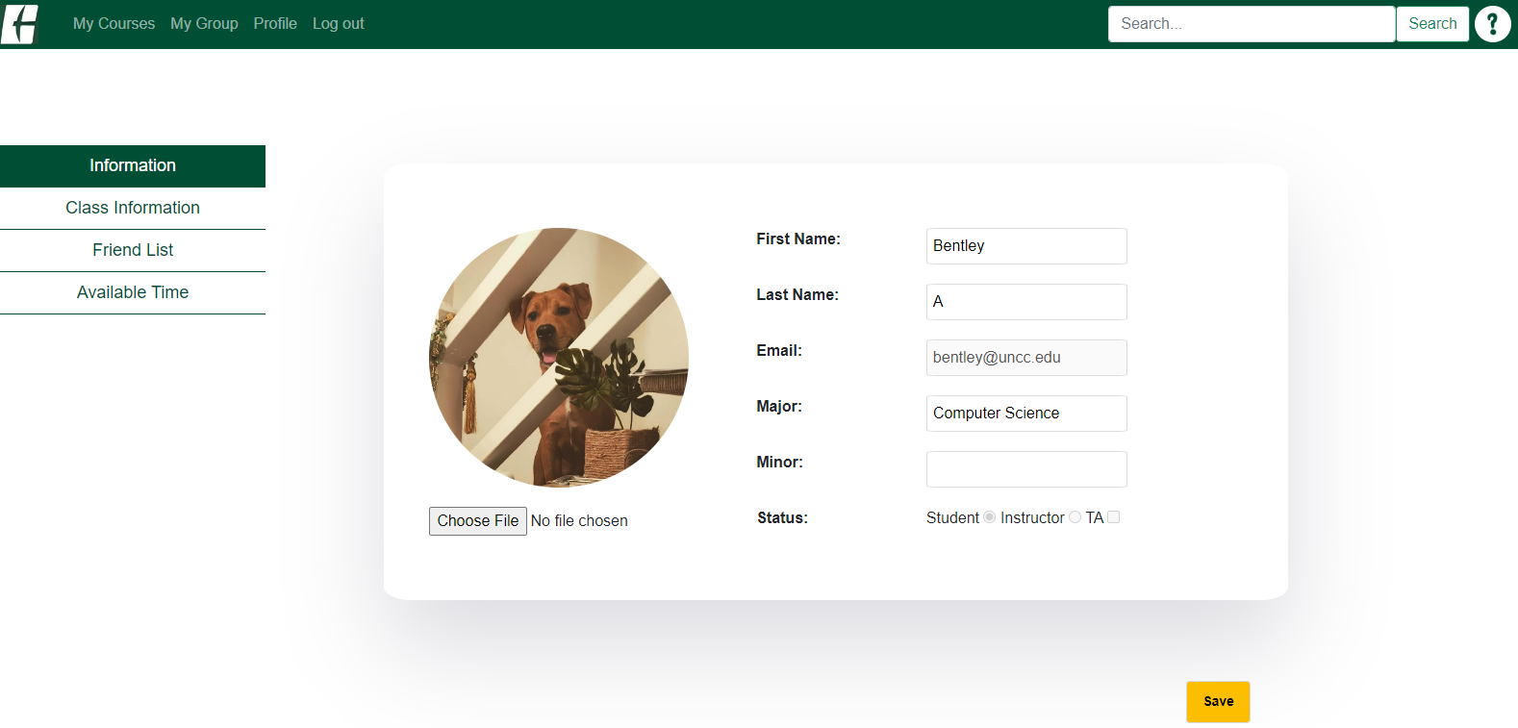
You can edit your profile information here.

Slide 24
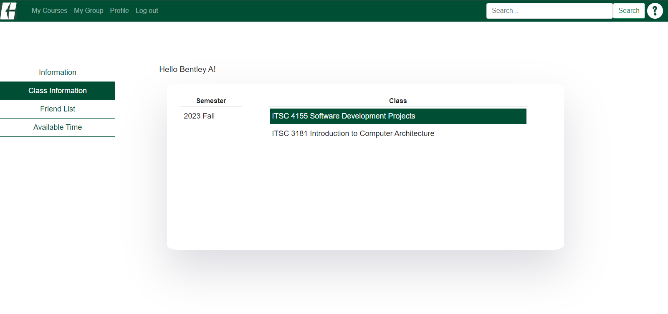
It shows your class information, and you can go to the course page by clicking it.

Slide 25
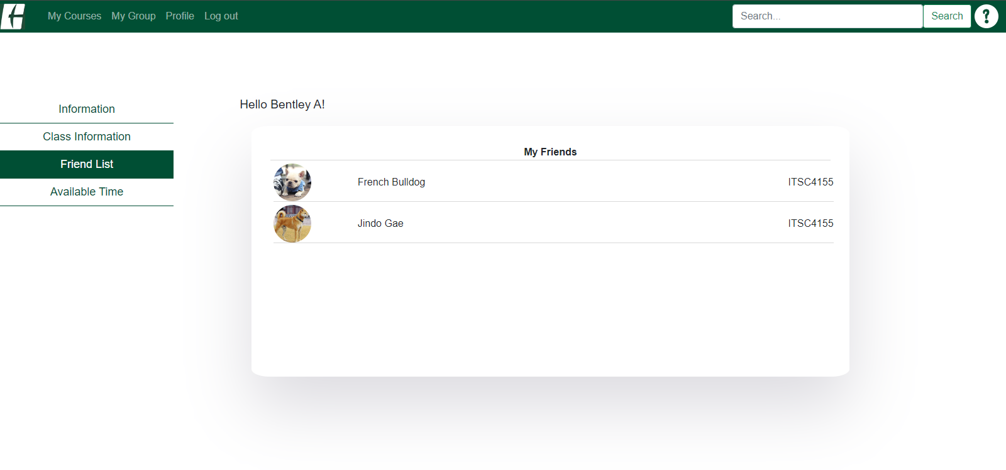
It shows people that you’re following.

Slide 26
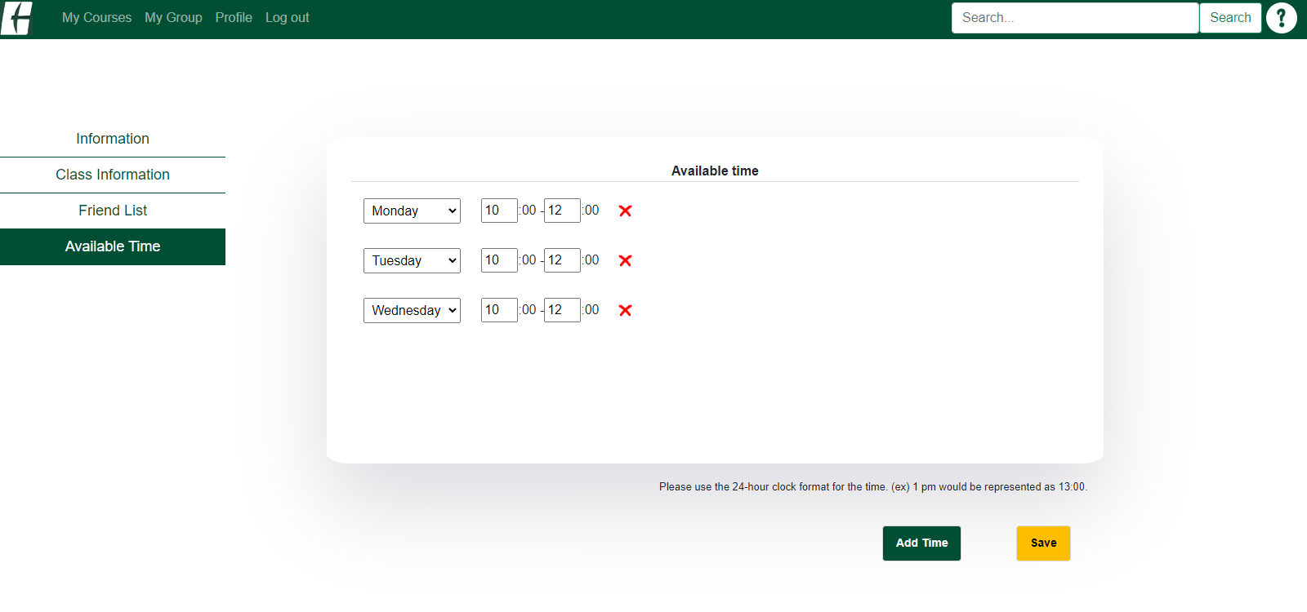
You can add your free time in this semester, which will be reflected in your group meeting page.
After adding/deleting time, make sure to save the information.

Slide 27
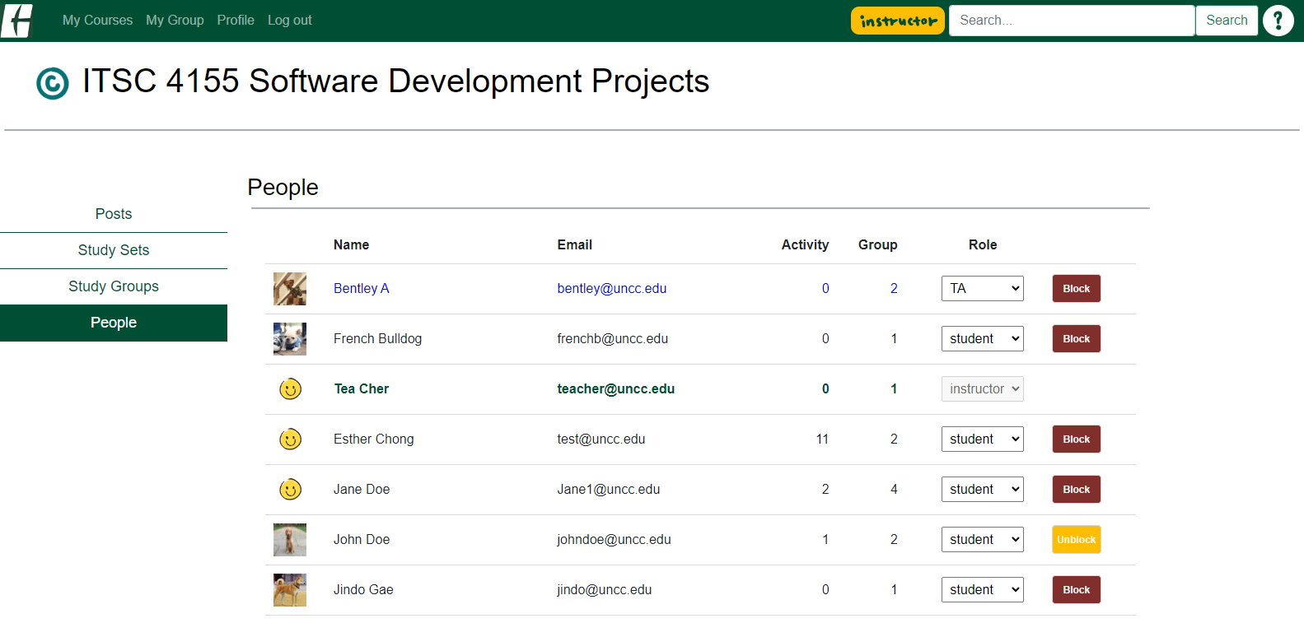
Instructors can change students’ roles to TA, and vice versa.
* Only the Instructor and TA in this course can see this page.
Instructors and TAs can block/unblock students who show inappropriate behavior.
Once a student is blocked, They still can read, but they can’t create any activity.

